Slide 1
Disk and I/O Tuning on Microsoft SQL Server
Kevin Kline
Director, Engineering Services; SQL Sentry
Microsoft MVP since 2004
Twitter/FB/LI: @KEKline, Blog http://KevinEKline.com

Slide 2
Agenda
Speaker bio
Fundamentals of Disk Hardware Architecture and Disk Sector Alignment
Fundamentals of the Hardware Architecture
Basics of IO, or Acronym Soup
DASD, RAID, SAN, and SSD
Disk and IO Performance Tuning
Best Practices
Resources
Q & A

Slide 3



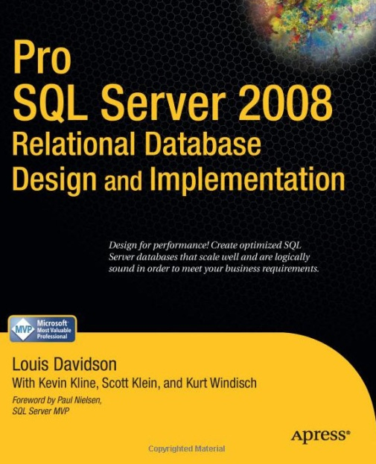






Your Speaker: Kevin Kline
My first book
Founding PASS
MVP Status
Notes:
SQL Server Expert for Quest Software
Former developer, DBA, and enterprise architect since ‘86
Former president of PASS (www.sqlpass.org)
Microsoft MVP since ‘04
Author of SQL in a Nutshell and 9 other books
Twitter @kekline
Blog http://KevinEKline.com

Slide 4

Fundamentals of the Disk Hardware Architecture
Cover mounting holes
(cover not shown)
Base casting
Adapted from a much more in-depth white paper called “Disk Partition Alignment Best Practices for SQL Server” by Jimmy May and Denny Lee
Available at http://sqlcat.com/whitepapers/archive/2009/05/11/disk-partition-alignment-best-practices-for-sql-server.aspx
Spindle
Slider (and head)
Case mounting holes
Actuator arm
Actuator axis
Platters
Actuator
Flex Circuit
(attaches heads
to logic board)
SATA interface
connector
Source: Panther Products
Power connector

Slide 5
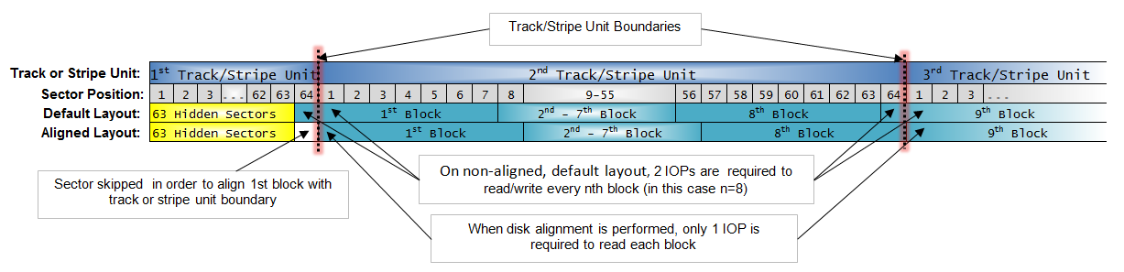
Disk Sector Alignment Issues
Disks are automatically misaligned on Windows 2003 and earlier…
Even if upgraded to a later OS or on a SAN.
Fixed using the DISKPART utility: http://support.microsoft.com/kb/929491
Followed by a reformat of the disks(s)

Slide 6
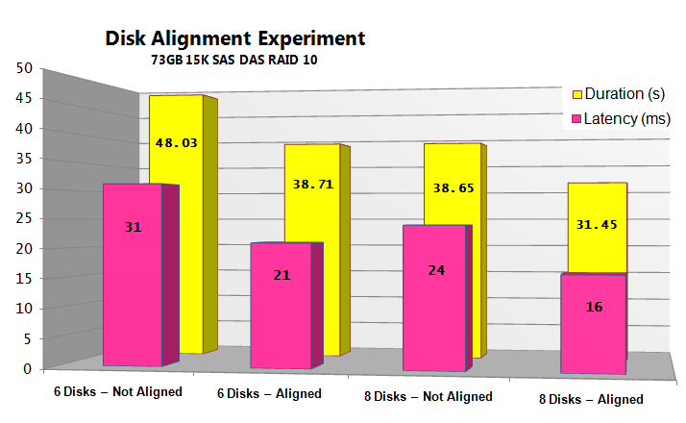
Performance Impact Graphic: A Picture’s Worth...
Disk Alignment Experiment
Latency & Duration on RAID 10, 64KB file allocation unit
6 disks vs. 8 disks
Not Aligned vs. Aligned
6 aligned disks performed as well as 8 non-aligned disks.
Thus, efficiencies of ~30% were achieved.
Notes:
Analysis resulted in the following conclusions:
--Note duration first (close) then latency (improved) for 6 disks vs. 8
Partition alignment produced significant improvement compared to non-aligned disks. The measurements document enhancements in excess of 30% for disk latency & duration.
The performance of six aligned disks was comparable to or better than eight non-aligned disks.
Not displayed is that partition alignment also increased throughput (as measured in bytes/sec) & reduced disk queue length. CPU differences were insignificant. Also not displayed is the value of memory: in all cases if DBCC DROPCLEANBUFFERS wasn’t performed, the query completed in ~3s with no physical I/O because the buffer cache was able to hold all the pages required to satisfy the query.
The work was done on a DELL PowerEdge 2950 with two dual core 3.00 GHz Intel Xeon processors, a PERC 5/E controller, and 8 GB of physical RAM. Six or eight disks, SAS DAS, 73GB 15K, were configured in RAID 10 with a block size of 64K & a stripe unit size of 64K. We installed Windows Server 2003 & SQL Server with all the latest-&-greatest patches. Finally we configured disks in systematic ways against which we executed a query which the customer used to benchmark performance. Prior to each run we executed DBCC DROPCLEANBUFFERS to purge the SQL Server buffer cache to ensure all data required to satisfy the workload was loaded from disk.

Slide 7
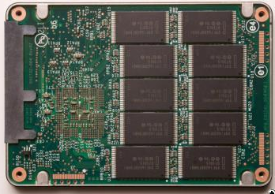
The “New” Hard Disk Drive (SSD)
What is Moore’s Law?
No moving parts! This is a game changer.

Slide 8
Fundamentals of the Hardware Architecture
Adapted from a much more in-depth session called “SQL Server Internals & Architecture”
Available at http://KevinEKline.com/Slides
Look for places where IO reads and writes occur…

Slide 9

The Life of an IOP
Query
Tree
INSERT, UPDATE, or
DELETE
Language
Event
Relational Engine
Protocol Layer
Optimizer
Cmd Parser
Query
Plan
SNI
Query Executor
SQL Server Network Interface
?
TDS
T-Log
OLE
DB
Storage Engine
Buffer Pool
- - - - - - - - - - - -
Data Cache
- - - - - - - - - - - -
Plan Cache
Trans-action Manager: Log & Lock Mgr
Access Methods
Buffer Manager
Data File
Oooh! So dirty!
?
Data
Write
Notes:
We’re doing the exact same thing behind the scenes, up to the point were the Access Manager gets busy. In this case, we’ll need to persist our data changes to disk. So we must now involve the Transaction Manager.
The Transaction Manager has two very important components:
The Lock Manager: Maintains concurrency and the ACID properties of transactions according to the specified isolation level.
The Log Manager: Controls writes to the transaction log, using a method called write-ahead logging.
Once the transaction log confirms that it has physically written the data change and passed the confirmation back to the TM, the TM in turn confirms to the AM, and then passes the modification request back to the BM for completion
But guess what, the BM has to confirm (as before) that the page is either in cache or on disk. And if it’s on disk, it must retrieve the page(s) to cache. A key point to remember is that the data is now changed, but only in cache and not on disk. This means the page is dirty and is not “cleaned” until it is flushed to disk. (A page is considered clean when it’s exactly the same on disk as in memory).
Flushing to disk happens thru a process called checkpointing. Unlike the lazywriter, checkpointing flushes the pages to disk but it does not remove them from cache. Checkpointing also ensures that a database never has to recovery past its last checkpoint. On a default install of SQL Server, that happens every minute or so (as long as there’s more than 10mb of data to write).

Slide 10
Spot the Opportunities!
What areas on the architecture slide represented an opportunity to make IO go faster by changing the underlying hardware?
Spot the Risks!
What areas on the architecture slide represented single point of failure or a serious risk if failure occurs?

Slide 11
The Basics of IO, or Acronym Soup
A single fixed disk is inadequate except for the simplest needs
Database applications require a Redundant Array of Inexpensive Disks (RAID) for:
Fault tolerance
Availability
Speed
Different levels offer different pros/cons
JBOD: Just a Bunch of Disks
RAID: Redundant Array of Inexpensive Disks
DAS: Direct Attached Storage
NAS: Network Attached Storage
SAN: Storage Area Network
Array: The box that exposes the LUN
HBA: The Network card used to communicate with the SAN
Fabric: The network between SAN components
CAS: Content Addressable Storage

Slide 12
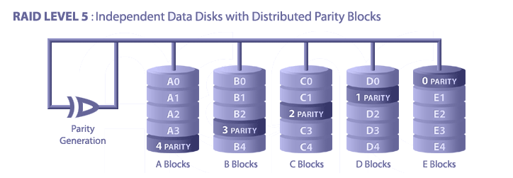
RAID Level 5
Pros
Highest Read data transaction rate; Medium Write data transaction rate
Low ratio of parity disks to data disks means high efficiency
Good aggregate transfer rate
Cons
Disk failure has a medium impact on throughput; Most complex controller design
Difficult to rebuild in the event of a disk failure (compared to RAID 1)
Individual block data transfer rate same as single disk
Notes:
Each entire data block is written on a data disk; parity for blocks in the same rank is generated on Writes, recorded in a distributed location and checked on Reads.
RAID Level 5 requires a minimum of 3 drives to implement

Slide 13
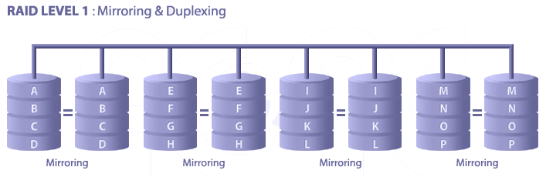
RAID Level 1
Pros
One Write or two Reads possible per mirrored pair
100% redundancy of data
RAID 1 can (possibly) sustain multiple simultaneous drive failures Simplest RAID storage subsystem design
Cons
High disk overhead (100%)
Cost
Notes:
For Highest performance, the controller must be able to perform two concurrent separate Reads per mirrored pair or two duplicate Writes per mirrored pair.
RAID Level 1 requires a minimum of 2 drives to implement
Other Pros:
Twice the Read transaction rate of single disks, same Write transaction rate as single disks; Transfer rate per block is equal to that of a single disk
100% redundancy of data means no rebuild is necessary in case of a disk failure, just a copy to the replacement disk

Slide 14
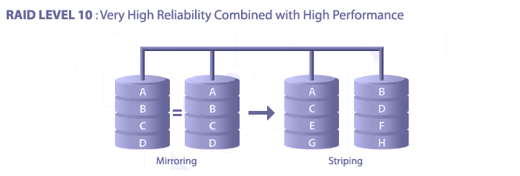
RAID Level 10 (a.k.a. 1 + 0)
Pros
RAID 10 is implemented as a striped array whose segments are RAID 1 arrays
RAID 10 has the same fault tolerance as RAID level 1 RAID 10 has the same overhead for fault-tolerance as mirroring alone
High I/O rates are achieved by striping RAID 1 segments
RAID 10 array can (possibly) sustain multiple simultaneous drive failures
Excellent solution for sites that would have otherwise go with RAID 1 but need some additional performance boost
Notes:
RAID Level 10 requires a minimum of 4 drives to implement.
Cons
Very expensive / High overhead
All drives must move in parallel to properly track, lowering sustained performance
Very limited scalability at a very high inherent cost
Note that RAID 0 + 1 is this diagram turned on its side. RAID 0 + 1 is excellent for logs.

Slide 15
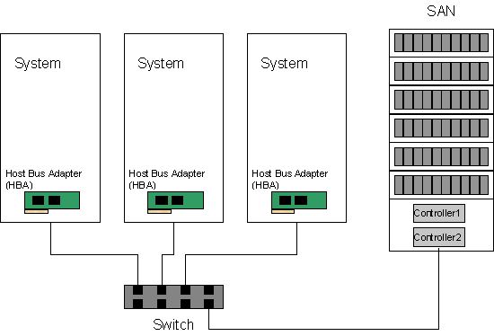
SAN (Storage Area Network)
Pros
Supports multiple systems
Newest technology matches RAID1 / RAID1+0 performance
Cons
Expense and setup
Must measure for bandwidth requirements of systems, internal RAID, and I/O requirements

Slide 16
Windows-based SAN IO Best Practices
Use Disk Alignment at 1024KB
Use GPT if MBR not large enough
Format partitions at 64KB allocation unit size
LUNs:
One partition per LUN
Only use Dynamic Disks when there is a need to stripe LUNs using Windows striping (i.e. Analysis Services workload)
Learn about these utilities:
diskpar.exe, diskpart.exe, and dmdiag.exe/diskdiag.exe
Check out Analyzing IO Characteristics and Sizing Storage Systems by Mike Ruthruff, Thomas Kejser, and Emily Watson
http://bit.ly/9cyLEG
Notes:
Note that you can use diskpart for most operations now. However, you still need diskpar.exe, dmdiag.exe, or diskdiag.exe to get the geometry of the drives and manage dynamic disks

Slide 17
SAN Worst Practices
Silos between DBAs and Storage Admins
Each needs to understand the other’s “world”
Volume versus Throughput
Shared storage environments
At the disk level and other shared components (i.e., service processors, cache, etc.)
One-size-fits-all type configurations
Storage vendor should have knowledge of SQL Server and Windows best practices when array is configured
Especially when advanced features are used (snapshots, replication, etc.)
Make sure you have the tools to monitor the entire path to the drives. Understand utilization of individual componets

Slide 18
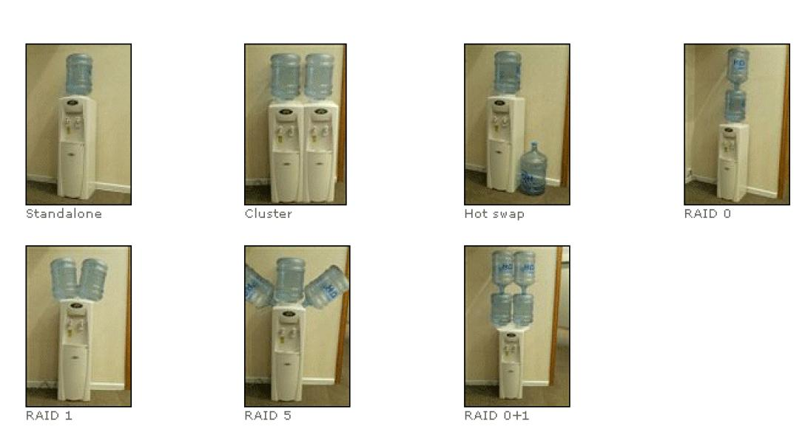
Overview by Analogy

Slide 19
Performance Tuning Starts with Monitoring
From the Windows POV
From the SQL Server POV

Slide 20

Windows Point of View of IO
Make sure to capture all of these for the complete picture…
Size impacts latency
Queue Length, latency, # of I/O’s can help identify problems related to sharing
Counter | Description
Disk Transfers/sec Disk Reads/sec Disk Writes/sec | Measures the number of IOPs Discuss sizing of spindles of different type and rotational speeds with vendor Impacted by disk head movement (i.e., short stroking the disk will provide more IOPs)
Average Disk sec/Transfer Average Disk sec/Read Average Disk sec/Write | Measures disk latency. Numbers will vary, optimal values for averages over time: 1 - 5 ms for Log (Ideally 1ms or better) 5 - 20 ms for Data (OLTP) (Ideally 10ms or better) <=25-30 ms for Data (DSS)
Average Disk Bytes/Transfer Average Disk Bytes/Read Average Disk Bytes/Write | Measures the size of I/Os being issued Larger I/O tends to have higher latency (example: BACKUP/RESTORE)
Avg. Disk Queue Length | Should not be used to diagnose good/bad performance Provides insight into the applications I/O pattern
Disk Bytes/sec Disk Read Bytes/sec Disk Write Bytes/sec | Measure of total disk throughput Ideally larger block scans should be able to heavily utilize connection bandwidth
Notes:
7/25/2012 2:57 PM
19
© 2006 Microsoft Corporation. All rights reserved. Microsoft, Windows, Windows Vista and other product names are or may be registered trademarks and/or trademarks in the U.S. and/or other countries.
The information herein is for informational purposes only and represents the current view of Microsoft Corporation as of the date of this presentation. Because Microsoft must respond to changing market conditions, it should not be interpreted to be a commitment on the part of Microsoft, and Microsoft cannot guarantee the accuracy of any information provided after the date of this presentation. MICROSOFT MAKES NO WARRANTIES, EXPRESS, IMPLIED OR STATUTORY, AS TO THE INFORMATION IN THIS PRESENTATION.
A common SQL Server myth is the high Avg. Disk Queue length is an indicator of bad performance. See the next slide

Slide 21
SQL Server Point of View of IO
Tool | Monitors | Granularity
sys.dm_io_virtual_file_stats | Latency, Number of IO’s, Size, Total Bytes | Database files
sys.dm_os_wait_stats | PAGEIOLATCH, WRITELOG | SQL Server Instance level (cumulative since last start – most useful to analyze deltas over time periods)
sys.dm_io_pending_io_requests | I/O’s currently “in-flight”. | Individual I/O’s occurring in real time. (io_handle can be used to determine file)
sys.dm_exec_query_stats | Number of … Reads (Logical Physical) Number of writes | Query or Batch
sys.dm_db_index_usage_stats | Number of IO’s and type of access (seek, scan, lookup, write) | Index or Table
sys.dm_db_index_operational_stats | I/O latch wait time, row & page locks, page splits, etc. | Index or Table
Xevents | PAGEIOLATCH | Query and Database file

Slide 22
SQL Server Point of View of IO
You demand more IO?!?
Sys.dm_os_wait_stats
Sys.dm_performance_counters

Slide 23
Monitoring Raw Disk Physical Performance
Avg. Disk sec/Read and Avg. Disk sec/Write
Transaction Log Access
Avg disk writes/sec should be <= 1 msec (with array accelerator enabled)
Database Access
Avg disk reads/sec should be <= 15-20 msec
Avg disk writes/sec should be <= 1 msec (with array accelerator enabled)
Remember checkpointing in your calculations!
Notes:
The Avg. Disk sec/Read and Avg. Disk sec/Write counters monitor the average number of seconds for read or write operations from or to a disk, respectively.
If your values significantly exceed those listed above for database access, you may want to increase the speed of your disk subsystem by either using faster drives or adding more drives to the system.
Checkpointing note: The above values will temporarily increase during periods of heavy I/O activity, such as during the checkpoint. When monitoring these values, take an average over a longer period of time, and/or monitor periods that do not contain a checkpoint.

Slide 24
Monitoring Raw I/O Physical Performance
Counters - Disk Transfers/sec, Disk Reads/sec, and Disk Writes/sec
Calculate the nbr of transfers/sec for a single drive:
First divide the number of I/O operations/sec by number of disk drives
Then factor in appropriate RAID overhead
You shouldn’t have more I/O requests (disk transfers)/sec per disk drive:
8KB I/O Requests 10K RPM 9-72 GB 15K RPM 9–18 GB
Sequential Write ~166 ~250
Random Read/Write ~90 ~110
Notes:
Monitors the rate of i/o operations handled by the disk subsystem. Remember that with several drives allocated to a logical disk volume, the counters monitor the total number of disk transfers for the entire volume.
Note: With the array accelerator enabled, you may actually see substantially higher I/O per second per drive rates than those suggested in the table above. This is due to the array controller caching some of these I/Os.

Slide 25
Estimating Average I/O
Collect long-term averages of I/O counters (Disk Transfers/sec, Disk Reads/sec, and Disk Writes/sec)
Use the following equations to calculate I/Os per second per disk drive:
I/Os per sec. per drive w/RAID 1 = (Disk Reads/sec + 2*Disk Writes /sec)/(nbr drives in volume)
I/Os per sec. per drive w/RAID 5 = (Disk Reads/sec + 4*Disk Writes /sec)/(nbr drives in volume)
Repeat for each logical volume. (Remember Checkpoints!)
If your values don’t equal or exceed the values on the previous slide, increase speeds by:
Adding drives to the volume
Getting faster drives
Notes:
This slide details how to estimate the average number of I/O requests per second for each disk drive.
With RAID 1, each write is duplicated onto a mirrored drive. Hence there are two-disk writes/sec.
With RAID 5, each write generates four I/O operations3: reading the data block, reading the parity block, writing the data block, and writing the parity block. Hence there are four disk writes/sec.
Repeat these steps for each logical volume. If the values significantly exceed those suggested above, increase the speed of your disk subsystem by adding more or using faster drives. As the equations illustrate, RAID 0 has the lowest impact on performance but offers no data protection. RAID 5, on the other hand, slows performance but offers low-cost data protection. Disk Reads/sec and Disk Writes/sec counters can be used to determine an application’s read-to-write ratio. They can also be used to profile disk I/O at a lower level. The sum of these two counters should equal the Disk Transfers/sec value.
Note: The above values will temporarily increase during periods of heavy I/O activity, such as during the checkpoint. When monitoring these values, take an average over a longer period of time, and/or monitor periods that do not contain a checkpoint.

Slide 26
Queue Lengths
Counters - Avg. Disk Queue Length and Current Disk Queue Length
Avg Disk Queue <= 2 per disk drive in volume
Calculate by dividing queue length by number of drives in volume
Example:
In a 12-drive array, max queued disk request = 22 and average queued disk requests = 8.25
Do the math for max: 22 (max queued requests) divided by 12 (disks in array) = 1.83 queued requests per disk during peak. We’re ok since we’re <= 2.
Do the math for avg: 8.25 (avg queued requests) divided by 12 (disks in array) = 0.69 queued requests per disk on average. Again, we’re ok since we’re <= 2.
Notes:
The Avg. Disk Queue Length and Current Disk Queue Length counters monitor both the average number and the instantaneous number of reads and writes queued for the selected disk.
Disk devices composed of multiple spindles, such as logical volumes configured on Smart Array controllers, will have several active requests at any point in time and several requests waiting for different disk drives. You therefore need to factor in the number of disks in the logical volume that are servicing the I/O requests.
For example, A twelve-drive array is facing a maximum of 22 queued disk requests and an average of 8.25 queued disk requests. Therefore, the array has 22/12=1.83 queued disk requests per disk drive during the peak, and 8.25/12=0.69 queued disk requests per disk drive on an average.
You should not average more than two queued disk requests per disk drive. The Avg. Disk Read Queue Length and Avg. Disk Write Queue Length counters provide you with more insight into what type of I/O requests are being queued the most.
Remember that these values will temporarily increase under spikes of heavy I/O, such as during the checkpoint.

Slide 27
Disk Time
Counters - % Disk Time (%DT), % Disk Read Time (%DRT), and % Disk Write Time (%DWT)
Use %DT with % Processor Time to determine time spent executing I/O requests and processing non-idle threads.
Use %DRT and %DWT to understand types of I/O performed
Goal is the have most time spent processing non-idle threads (i.e. %DT and % Processor Time >= 90).
If %DT and % Processor Time are drastically different, then there’s usually a bottleneck.
Notes:
The % Disk Time, % Disk Read Time, and % Disk Write Time counters monitor the percentage of time spent servicing particular I/O requests during the sampling interval.
Use the % Disk Time counter in conjunction with the % Processor Time counter to determine the time the system spends executing I/O requests or processing non-idle threads. Use the % Disk Read Time and % Disk Write Time counters to gain a further insight into the type of I/O being performed.
Your goal is to have a high percentage of time being spent executing non-idle threads (high % Processor Time) AND executing I/O (high % Disk Time). On a highly optimized system, these counters consistently measure at over 90 percent.
If one of these counters reads substantially lower than the other, this usually indicates a bottleneck, and further investigation is necessary. With high % Disk Time, use the % Disk Read Time and % Disk Write Time counters to get the I/O breakdown. With high % Processor Time, use the % User Time and % Privileged Time to get further CPU utilization breakdown.

Slide 28
Database I/O
Counters – Page Reads/sec, Page Requests/sec, Page Writes/sec, and Readahead Pages/sec
Page Reads/sec
If consistently high, it may indicate low memory allocation or an insufficient disk drive subsystem. Improve by optimizing queries, using indexes, and/or redesigning database
Related to, but not the same as, the Reads/sec reported by the Logical Disk or Physical Disk objects
Page Writes/Sec: Ratio of Page Reads/sec to Page Writes/sec typically ranges from 5:1 and higher in OLTP environments.
Readahead Pages/Sec
Included in Page Reads/sec value
Performs full extent reads of 8 8k pages (64k per read)
Notes:
Page Reads/sec
The Page Reads/sec counter monitors the number of pages read from disk per second.
Depending on your environment, this counter may be high before your system reaches a steady state, and then gradually decrease. If your database fits entirely into memory, the counter should be zero. If the counter is consistently high, it may indicate low memory allocation or an insufficient disk drive subsystem. You may be able to reduce the number of Reads/sec by optimizing your queries, using indexes, and/or redesigning your database.
Page Reads/sec is related to, but not the same as, the Reads/sec reported by the Logical Disk or Physical Disk objects. Multiple pages can be read with a single logical or physical disk read. The number of physical reads and Page Reads should be roughly the same in OLTP environments.
Page Requests/sec
A Page Request occurs when SQL Server looks in the buffer pool for a database page. If the page is in the buffer pool, it can be processed immediately. If the page is not in the buffer pool, a Page Read is issued.
Page Writes/sec
Eventually all modified database pages have to be written back to disk. The Page Writes/sec counter reports the rate at which this occurs. The ratio of Page Reads/sec to Page Writes/sec typically ranges from 2:1 to 5:1 in OLTP environments. Most Business Intelligence applications perform few updates and, as a result, few Page Writes. Excessive Page Writes can be caused by insufficient memory or frequent checkpoints.
Readahead Pages/sec
The SQL Server storage architecture supports optimizations that allow SQL Server to determine in advance which database pages will be requested (read-ahead).
A full scan, in which every page of an index or table is read, is the simplest case. Read-ahead occurs when SQL Server issues the read request before the thread that is processing the query or transaction needs the page. Readahead Pages/sec is included in the Page Reads/sec counter. The number of read requests issued due to cache misses (the requested page was not found in the data cache) can be calculated by subtracting Readahead Pages/sec from Page Reads/sec.
SQL Server typically reads entire extents when performing read-aheads. All eight pages of an extent will be read with a single 64KB read. Read-aheads will cause the Avg. Disk Bytes/Read reported by the Logical Disk or Physical Disk object to be larger than 8KB. It is important to note that read-aheads are performed in sequential order, allowing much higher throughput than random accesses.

Slide 29
Best Practices for Backup and Recovery IO
For most transactional systems, measure disk IO capacity in trans/sec speed
For BI systems and for the B&R component of transactional systems, measure the MB/sec speed
B&R tips:
Don’t spawn more than 1 concurrent B&R session per CPU (CPUs minus 1 is even better)
Test B&R times comparing sequential to parallel processing.
Parallel is often worse, especially on weak IO subsystems.

Slide 30
Best Practices for SQL Server IO Planning on an OLTP Workload
Do: Base sizing on spindle count needed to support the IOPs requirements with healthy latencies
Don’t: Size on capacity
Spindle count rule of thumb
10K RPM: 100 – 130 IOPs at “full stroke”
15K RPM: 150 – 180 IOPs at “full stroke”
SSD vs HD? 4469 vx 380 IOPs http://www.emc.com/collateral/hardware/white-papers/h6018-symmetrix-dmx-enterprise-flash-with-sql-server-databases-wp.pdf
Can achieve 2x or more when ‘short stroking’ the disks (using less than 20% capacity of the physical spindle)
These are for random 8K I/O
Remember the RAID level impact on writes (2x RAID 10, 4x RAID 5)
Cache hit rates or ability of cache to absorb writes may improve these numbers
RAID 5 may benefit from larger I/O sizes

Slide 31
Strategies for Enhancing IO
Within SQL Server:
Tuning queries (reads) or transactions (writes)
Tuning or adding indexes, fill factor
Segregate busy tables and indexes using file/filegroups
Partitioning tables
Within hardware:
Adding spindles (reads) or controllers (writes)
Adding or upgrading drive speed
Adding or upgrading controller cache. (However, beware write cache without battery backup.)
Adding memory or moving to 64-bit memory.

Slide 32
Top 10 Storage Tips
Understand the IO characteristics of SQL Server and the specific IO requirements / characteristics of your application.
More / faster spindles are better for performance
Ensure that you have an adequate number of spindles to support your IO requirements with an acceptable latency.
Use filegroups for administration requirements such as backup / restore, partial database availability, etc.
Use data files to “stripe” the database across your specific IO configuration (physical disks, LUNs, etc.).
Try not to “over” optimize the design of the storage; simpler designs generally offer good performance and more flexibility.
Unless you understand the application very well avoid trying to over optimize the IO by selectively placing objects on separate spindles.
Make sure to give thought to the growth strategy up front. As your data size grows, how will you manage growth of data files / LUNs / RAID groups?.
Validate configurations prior to deployment
Do basic throughput testing of the IO subsystem prior to deploying SQL Server. Make sure these tests are able to achieve your IO requirements with an acceptable latency. SQLIO is one such tool which can be used for this. A document is included with the tool with basics of testing an IO subsystem. Download the SQLIO Disk Subsystem Benchmark Tool.

Slide 33
Top 10 Storage Tips
Always place log files on RAID 1+0 (or RAID 1) disks.
This provides:
better protection from hardware failure, and
better write performance.
Note: In general RAID 1+0 will provide better throughput for write-intensive applications. Generally, RAID 1+0 provides better write performance than any other RAID level providing data protection, including RAID 5.
Isolate log from data at the physical disk level
When this is not possible (e.g., consolidated SQL environments) consider I/O characteristics and group similar I/O characteristics (i.e. all logs) on common spindles. Combining heterogeneous workloads (workloads with very different IO and latency characteristics) can have negative effects on overall performance (e.g., placing Exchange and SQL data on the same physical spindles).
Consider configuration of TEMPDB database
Make sure to move TEMPDB to adequate storage and pre-size after installing SQL Server.
Performance may benefit if TEMPDB is placed on RAID 1+0 (dependent on TEMPDB usage).
For the TEMPDB database, create 1 data file per CPU, as described later.

Slide 34
Top 10 Storage Tips
Lining up the number of data files with CPU’s has scalability advantages for allocation intensive workloads.
It is recommended to have .25 to 1 data files (per filegroup) for each CPU on the host server.
This is especially true for TEMPDB where the recommendation is 1 data file per CPU.
Dual core counts as 2 CPUs; logical procs (hyperthreading) do not.
Don’t overlook some of SQL Server basics
Data files should be of equal size – SQL Server uses a proportional fill algorithm that favors allocations in files with more free space.
Pre-size data and log files.
Do not rely on AUTOGROW, instead manage the growth of these files manually. You may leave AUTOGROW ON for safety reasons, but you should proactively manage the growth of the data files.
Don’t overlook storage configuration bases
Use up-to-date HBA drivers recommended by the storage vendor

Slide 35
10 Rules for Better IO Performance
Put SQL Server data devices on a non-boot disk
Put logs and data on separate volumes and, if possible, on independent SCSI channels
Pre-size your data and log files; Don’t rely on AUTOGROW
RAID 1 and RAID1+0 are much better than RAID5
Tune TEMPDB separately
Create 1 data file (per filegroup) for physical CPU on the server
Create data files all the same size per database
Add spindles for read speed, controllers for write speed
Partitioning … for the highly stressed database
Monitor, tune, repeat…
Notes:
Do not put SQL Server data devices on the boot disk
Put logs on a RAID 1 on an independent SCSI channel
Put data on a RAID 5 on an independent SCSI channel
If read disk queuing is high on your data device (avg 2 or higher per spindle) put non-clustered indexes in a new filegroup on a RAID 5 on an independent SCSI channel
If tempdb is stressed (consistent blocking in dbid 2 is one common indicator) and you cannot redesign to relieve the stress put tempdb on a RAID 1+0 on an independent SCSI channel and the tempdb log on yet another RAID 1+0 on an independent channel.
If your database holds highly sensitive data consider RAID 1+0 over RAID 5.
Avoid unnecessary complexity (KISS).
With thanks to Bill Wunder and his article on the SIGs at the PASS website (http://sigs.sqlpass.org/Resources/Articles/tabid/35/ctl/ArticleView/mid/349/articleId/58/Default.aspx).

Slide 36
Trending and Forecasting
Trending and forecasting is hard work!
Create a tracking table to store:
Number of records in each table
Amount of data pages and index pages, or space consumed
Track I/O per table using fn_virtualfilestats
Run a daily job to capture data
Perform analysis:
Export tracking data to Excel
Forecast and graph off of data in worksheet
Go back to step 2d and repeat

Slide 37
Call to Action – Next Steps
Learn more about SQL Sentry solutions for SQL Server: http://www.sqlsentry.net/
Download trials
Read white papers
Review case studies
Ask for a live demo!

Slide 38
Follow-up Resources
Start at www.sqlcat.com: They work on the largest, most complex SQL Server projects worldwide
MySpace: 4.4m concurrent users at peak, 8b friend relationships, 34b e-mails, 1PB store, scale-out using SSB and SOA. http://bit.ly/7XkHah
Bwin: 30000 database tran/sec, motto: “Failure is not an option”; 100TB store. http://bit.ly/NYi3if & http://bit.ly/OFb24A
Korea Telecom: 26m customers; 3 TB Data Warehouse http://bit.ly/OjaVPH
Shares deep technical content with SQL Server community.
Bruce Worthington’s paper: Performance Tuning Guidelines for Windows Server 2008. http://bit.ly/Mueuma

Slide 39
Additional Resources
SQL Server I/O Basics
http://www.microsoft.com/technet/prodtechnol/sql/2005/iobasics.mspx
SQL Server PreDeployment Best Practices
http://sqlcat.com/whitepapers/archive/2007/11/21/predeployment-i-o-best-practices.aspx
Disk Partition Alignment Best Practices for SQL Server
http://sqlcat.com/whitepapers/archive/2009/05/11/disk-partition-alignment-best-practices-for-sql-server.aspx
SQL Server Storage Engine blog at
http://blogs.msdn.com/sqlserverstorageengine
SQLSkills.com blogs!

Slide 40

Twitter
In case you hadn’t heard, there’s a thriving SQL Server community on twitter.
Get an alias… now!
Download tweetdeck or another Twitter utility.
Add: www.tinyurl.com/sqltweeps.
Follow #sqlhelp and your peers.
Follow me: www.twitter.com/kekline.

Slide 41
Questions ?
Send questions to me at: kkline@sqlsentry.net
Twitter, Facebook, LinkedIn @kekline
Columns – SQLMag.com and DBTA.com
Rate Me – http://SpeakerRate.com/kekline/
Content – http://KevinEKline.com/Slides/

